Slide 1

Lecture 4
Data Mining Algorithms for Classification

Slide 2

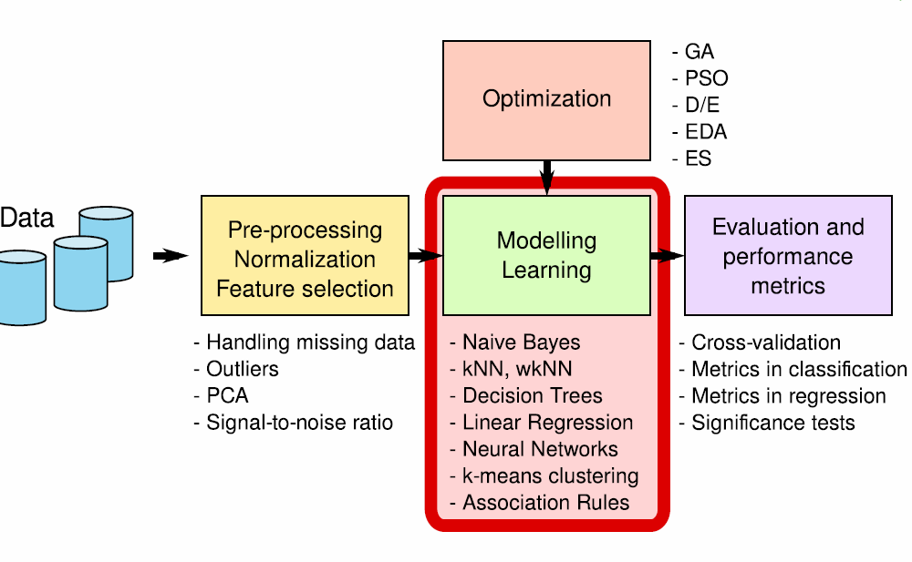

Slide 3

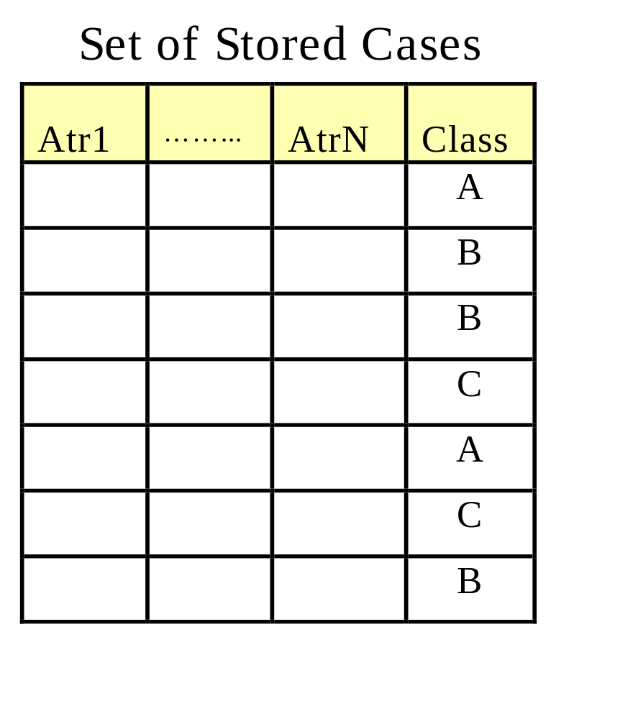
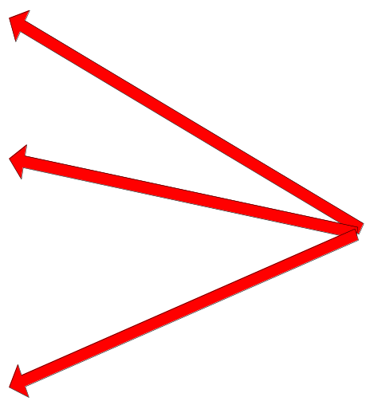
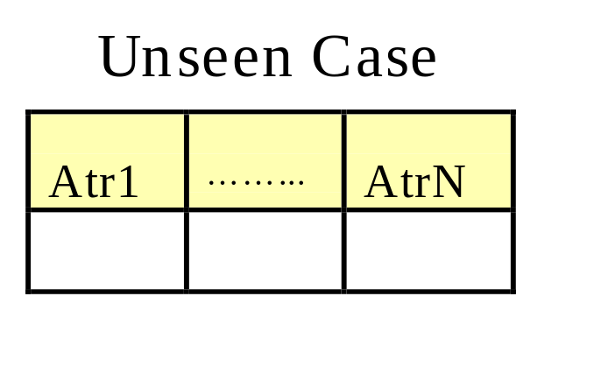
Store the training records
Use training records to
predict the class label of
unseen cases

Slide 4

Examples:
  Rote-learner
    Memorizes entire training data and performs classification only if attributes of record match one of the training examples exactly
  Nearest neighbor
    Uses k “closest” points (nearest neighbors) for performing classification

Slide 5







Basic idea:
  If it walks like a duck, quacks like a duck, then it’s probably a duck
Compute Distance
Test Record
Training Records
Choose k of the “nearest” records

Slide 6

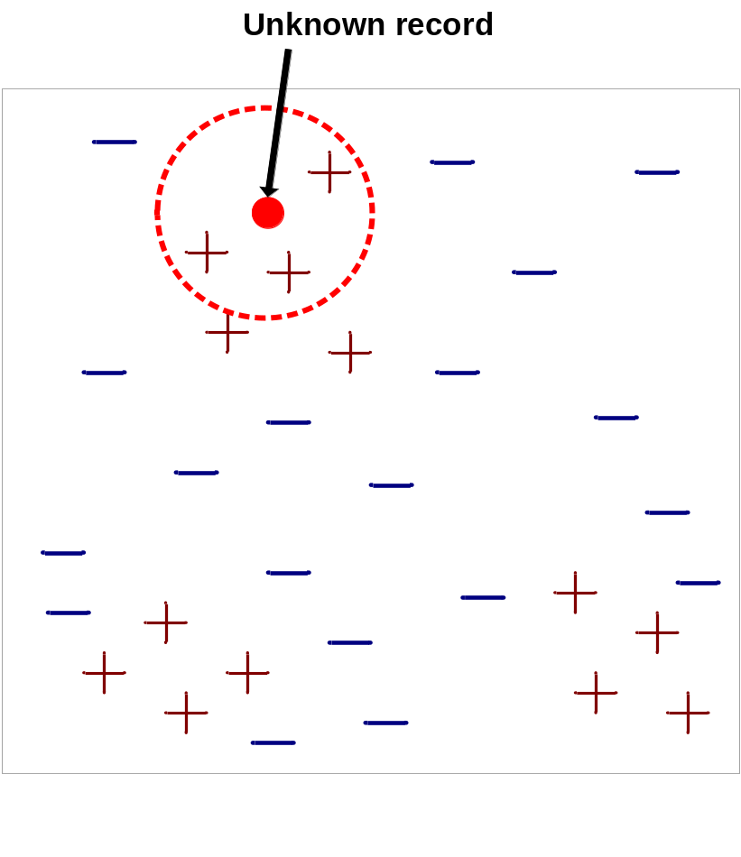
Requires three things
  The set of stored records
  Distance Metric to compute distance between records
  The value of k, the number of nearest neighbors to retrieve
To classify an unknown record:
  Compute distance to other training records
  Identify k nearest neighbors
  Use class labels of nearest neighbors to determine the class label of unknown record (e.g., by taking majority vote)

Slide 7


K-nearest neighbors of a record x are data points that have the k smallest distance to x

Slide 8

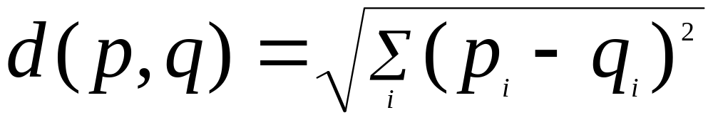
Compute distance between two points:
  Euclidean distance
Determine the class from nearest neighbor list
  take the majority vote of class labels among the k-nearest neighbors
  Weigh the vote according to distance
    weight factor, w = 1/d
    weight factor, w = 1-d

Slide 9

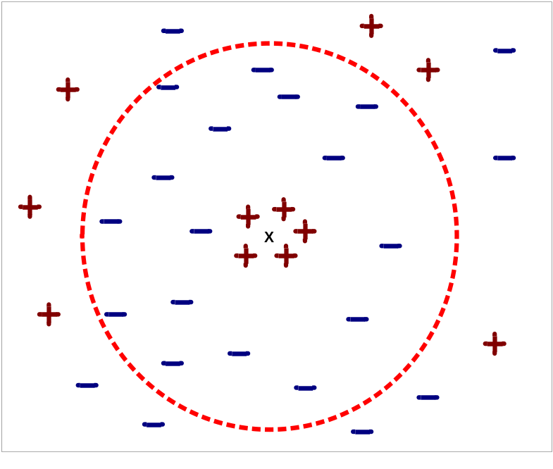
Choosing the value of k:
  If k is too small, sensitive to noise points
  If k is too large, neighborhood may include points from other classes

Slide 10
Scaling issues
  Attributes may have to be scaled to prevent distance measures from being dominated by one of the attributes
  Example:
    height of a person may vary from 1.5m to 1.8m
    weight of a person may vary from 90lb to 300lb
    income of a person may vary from $10K to $1M

Slide 11
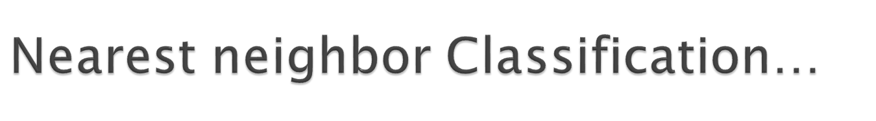
k-NN classifiers are lazy learners
  It does not build models explicitly unlike eager learners such as decision tree induction and rule-based systems
  Classifying unknown records are relatively expensive – does not scale well when training set is large as each classification requires searching the entire training dataset

Slide 12

For nominal data, Euclidean distance cannot be used and a distance measure based on whether an exact match exists or not can be used
For the credit scoring example we will use k=3 and distance between two instances is based on a 0/1 scheme

Slide 13

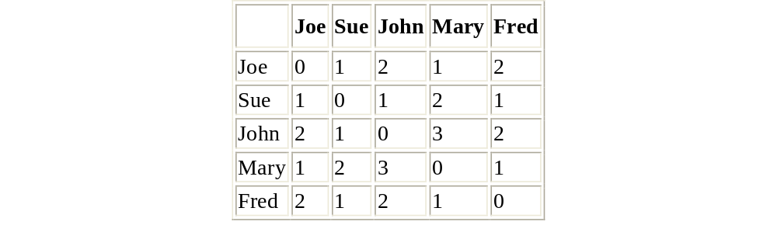
To classify Sam (Debt=High, Income=High, Married = Yes), we find the 3 nearest neighbours to Sam, who are Joe, Sue, and Mary
The risk values of the neighbours are Good, Good and Poor, which means that Sam is classified as a Good risk

Slide 14

Accuracy of prediction depends on the value of k and the choice of distance metric
Most DM products choose a value of 10 as default for k
Distance metric needs to be defined by the miner – this requires some care
In datasets that contain numeric data, need to be careful with attributes that are defined on different scale ranges – eg Income and Age
for nominal data (E.g. in age groupings) need to recognise that distance between pairs of age groupings are not always the same:
  d((21, 30), (51,60)) > d((21, 30), (41,50))

Slide 15

Chapter 4, Data Mining: Practical Machine Learning Tools and Techniques (3nd edition) / Ian Witten, Eibe Frank; Elsevier, 2011.
Chapter 4, Introduction to Data Mining / Pang-Ning Tan, Michael Steinbach and Vipin Kumar, Pearson Education, Inc, 2006.

